Slide 1
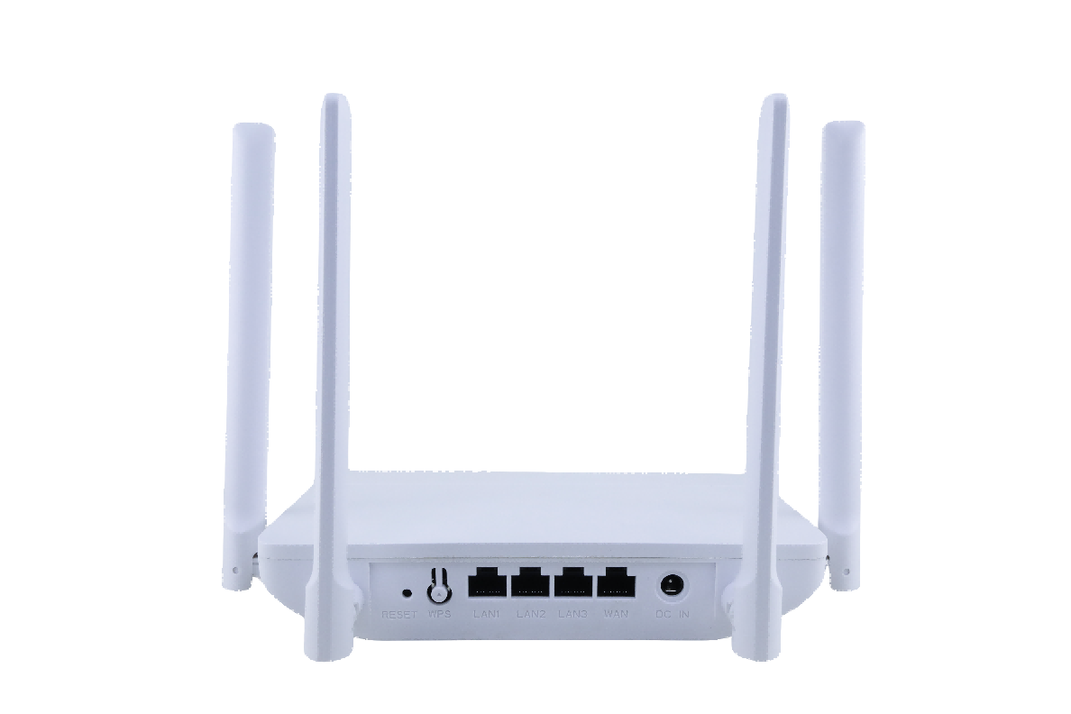
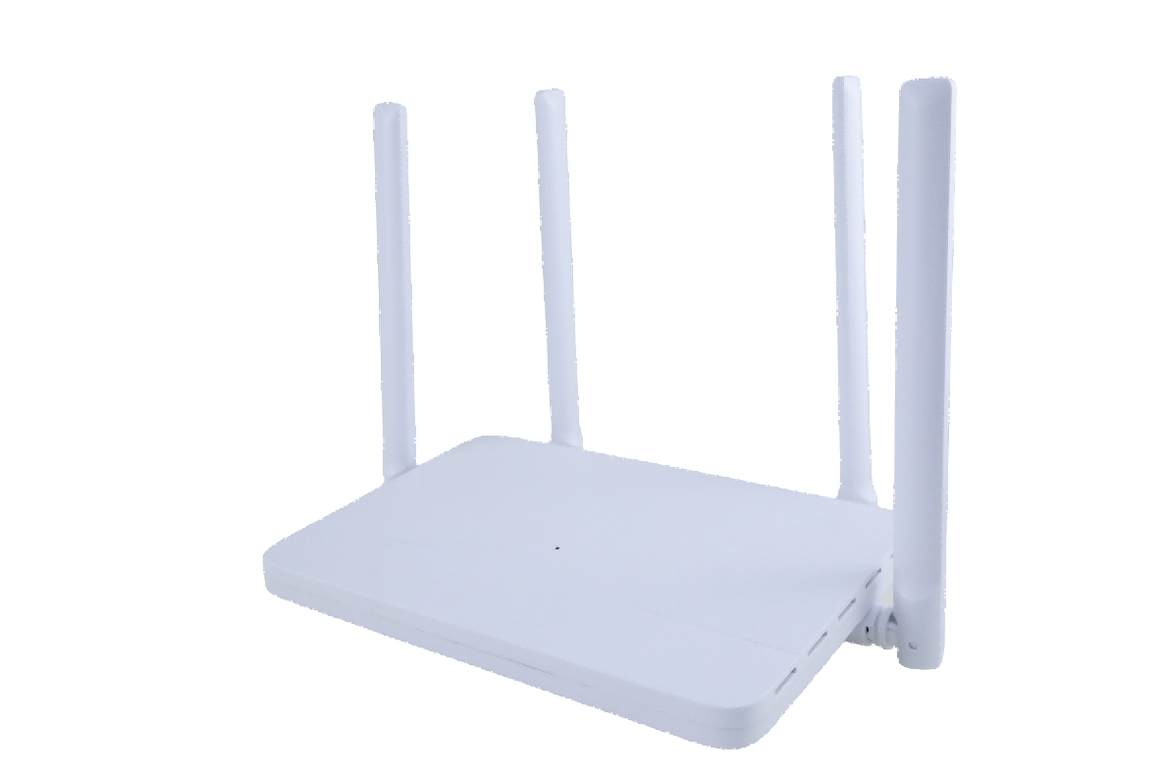
Product Overview

Slide 2
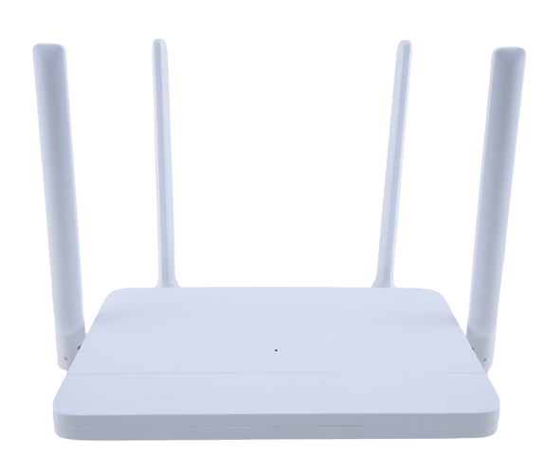
Product Overview
AX1500 Wi-Fi 6 Router
Main Features
1: Wi-Fi 6 Technology—AX1500 is equipped with the latest wireless technology, Wi-Fi 6, for faster speeds, greater capacity, and reduced network congestion.
2: 1.5 Gbps Speeds: Enjoy smooth streaming, downloading, and gaming all without buffering with Wi-Fi speeds of 1.5 Gbps.
3：Connect More Devices: Wi-Fi 6 technology communicates more data to more devices using OFDMA technology and MU-MIMO.
4：Extensive Coverage: Beamforming and four antennas combine to deliver focused reception to devices far away.

Slide 3
Key Parameters
Hardware
CPU | RTL8197H+RTL8832BR+RTL8367RB
GE WAN Port | 1 x10/100/1000Mbps WAN
GE LAN Port | 3x10/100/1000Mbps LAN
Button | 1 x Reset, 1 x W PS, 1 x DC IN
Memory | 128MB
Flash | 128MB
Antenna | 2.4G: 5dBi; 5G: 5dBi
Power adapter | 12V, 1A
Rated voltage /frequency | input:100-240VAC, 50/60Hz
Wireless
Wireless standard | IEEE 802.11b/g/n/a/ac/ax
Rate | 1500Mbps 5GHz: 1200Mbps 2.4GHz: 300Mbps
Frequency band | 2.4GHz, 5GHz
Bandwidth | 2.4GHz: 20/40MHZ; 5GHz: 20/40/80MHz
Channel | 2.4GHz band: support 13 channels（channel 1～13）
 | 5GHz band：support channels: 36，40，44，48，149，153，157，161，165
Sensitivity | 802.11b: -90dBm /802.11g: -76dBm / 802.11n: -70dBm /802.11ac: -60dBm/802.11ax: -54dBm
Wi-Fi security | WPA / WPA2/ WPA3, WPA-PSK/ WPA2-PSK encryption
Features | QAM-1024, OFDMA, MU-MIMO, BSS coloring
Functions | TX Beamforming, SSID hidden, signal intensity regulation, WPS, Wi-Fi Schedule

Slide 4
Key Parameters
Software
Working mode | gateway, bridge, repeater
NAT forwarding | virtual server, DMZ, uPnP
WAN access type | PPPoE，Dynamic IP, Static IP，PPTP, L2TP
Quality of Service | QoS, bandwidth control
DHCP | address reservation, DHCP Client List
DDNS | NO-IP, DynDNS
Signal strength | through wall mode, standard mode, energy- conservation mode
System tools | login password change, restart, restore to default, firmware upgrade, configuration backup/restore，remote firmware upgrade
Functions | Easymesh TR-069
 | IPv4/IPv6
 | Network Time Protocol, remote management
 | Firewall, URL filter, MAC filter, IP filter, port filter, domain filter, IGMP Proxy
 | VPN pass through（IPsec, PPTP, L2TP）
 | network status, network diagnostics
Others
Operating temperature 0℃～+40℃
Storage temperature -10℃～+70℃
Working humidity 10%～90%, Non-condensing
Storage humidity 10%～90%, Non-condensing
Package Contents Device*1
User manual*1
RJ45 ethernet cable*1
Power adapter*1
Weight Dimension
Giftbox 0.492KG 260mm*248mm*45mm
Carton 11.15KG 525mm*475mm*280mm
Pallet 236.5KG 1200mm*1000mm*1525mm
20pcs/ctn
20ctns/pallet

